Slide 1



K-Means Clustering Algorithm

Slide 2

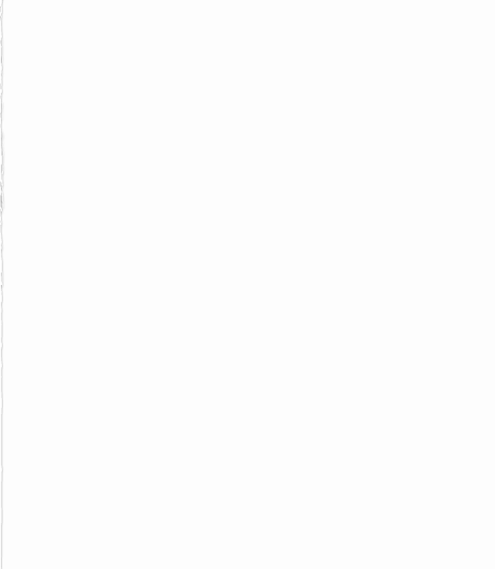
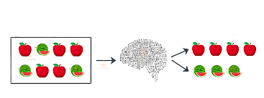
What is Unsupervised Learning?
Analyze unlabeled data
Labels or scores are not provided for training data
Algorithms discover hidden patterns without the need for human intervention
Ideal for Data Analysis, Customer segmentation and Image Recognition.
INPUT
Model
OUTPUT

Slide 3
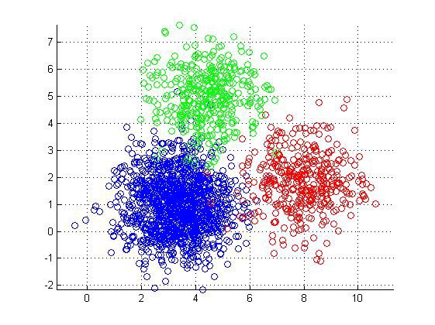
Then what is Clustering?
Data Mining Technique
Group unlabeled data based on their “similarities” or “differences”
Exclusive/Hard clustering
Hierarchical clustering
Probabilistic/Soft clustering

Slide 4
What does “K” really mean?

Slide 5
What does “K” really mean?
K → Number of clusters we want to form
Mean → Measure of similarity will be Distance

Slide 6
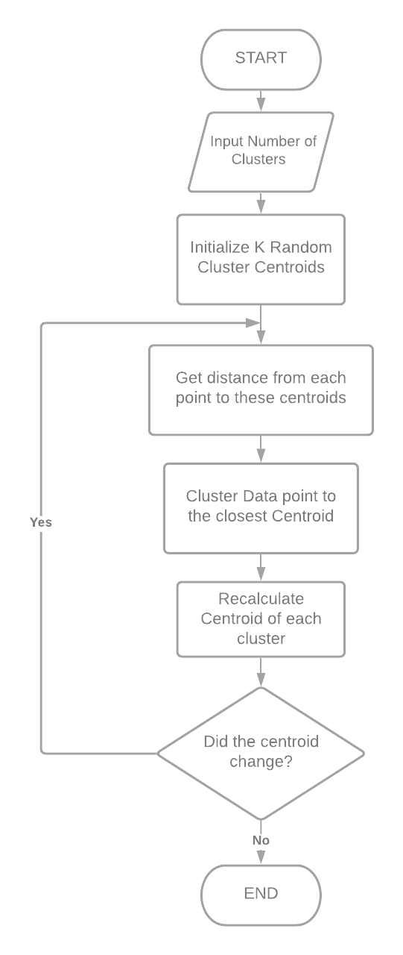
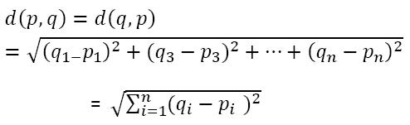
Flow of the Algorithm
For a fixed number of clusters
Calculation of Distance
For n dimensions

Slide 7
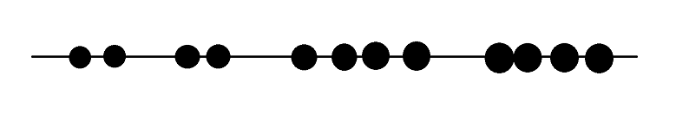

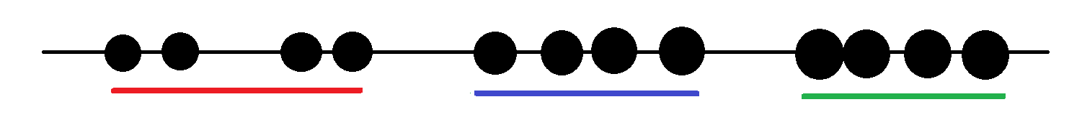
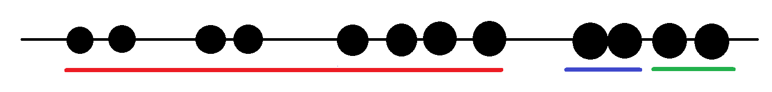
Evaluating Clusters
Lack of a direct loss function
1 Dimension Example:
Q. Which Clustering is the Best? Vote in the poll!
A. B. C.

Slide 8
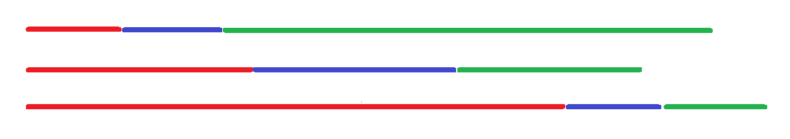
Concept of Variance and WCSS
Answer: B
But what do these lines represent?

Slide 9
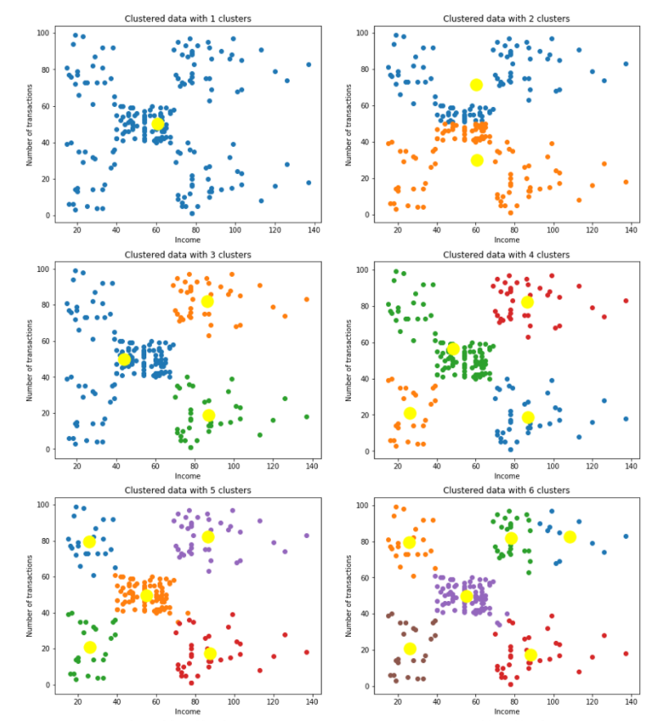
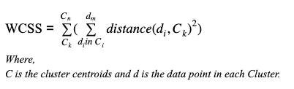
Concept of Variance and WCSS
Sum of squares of distances of every data point from its corresponding cluster centroid which is called WCSS ( Within-Cluster Sums of Squares).

Slide 10
How to select K?
Elbow method
Perform K means clustering on different values of K ranging from 1 to any upper limit.
For each K, calculate WCSS
Plot the value for WCSS with the number of clusters K.
The location of a bend (knee) in the plot is generally considered as an indicator of the appropriate number of clusters. i.e. the point after which WCSS doesn’t decrease more rapidly is the appropriate value of K.

